Slide 1


Student Academic performance
Presenter Name
Vishwajit Mishra
Arpita Mondal
Pooja Arora
Payel Patra
Souradip Maji

Slide 2




Introduction
Academic performance is the measurement of student achievement across various academic subjects. Teachers and education officials typically measure achievement using classroom performance, graduation rates, and results from standardized tests.

Slide 3
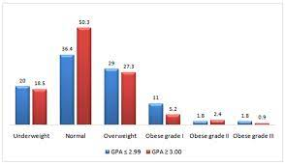
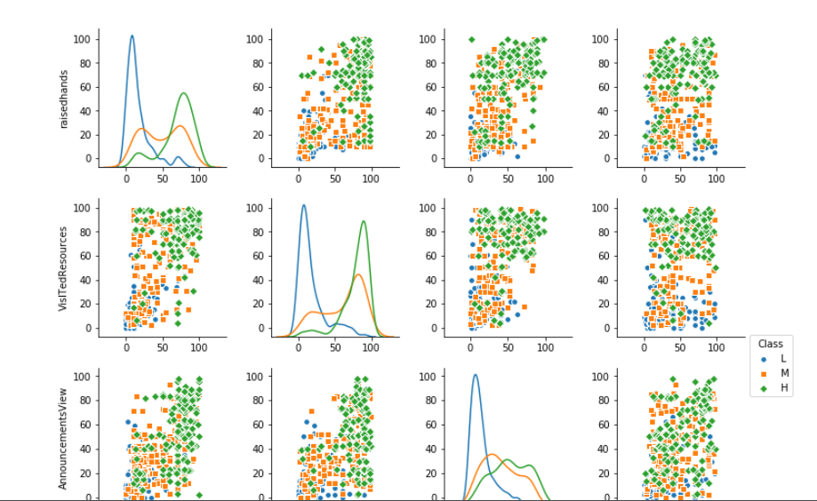
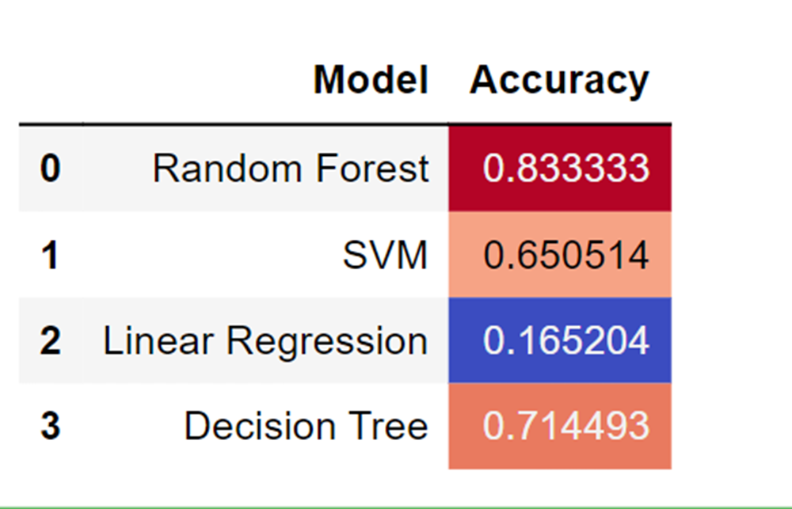
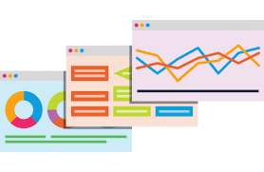
Agenda
Project Objective & Scope
Data Description
Methodology
Data Preprocessing
Models Used
Accuracy Comparison
Inference Table
Future Scope Improvements

Slide 4
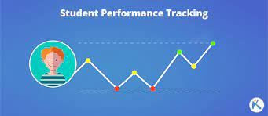
Project Objective & Scope
The goal of this project was to examine a number of ML algorithms that were capable of adjusting to categorical data and attempting to predict student performance. Some parts of our problem that make it unique are: There are 3 classes and most of our data is categorical data and not purely quantitative. Our goal with this was to perform some initial data visualization and to determine which classifier handles this data the best.

Slide 5
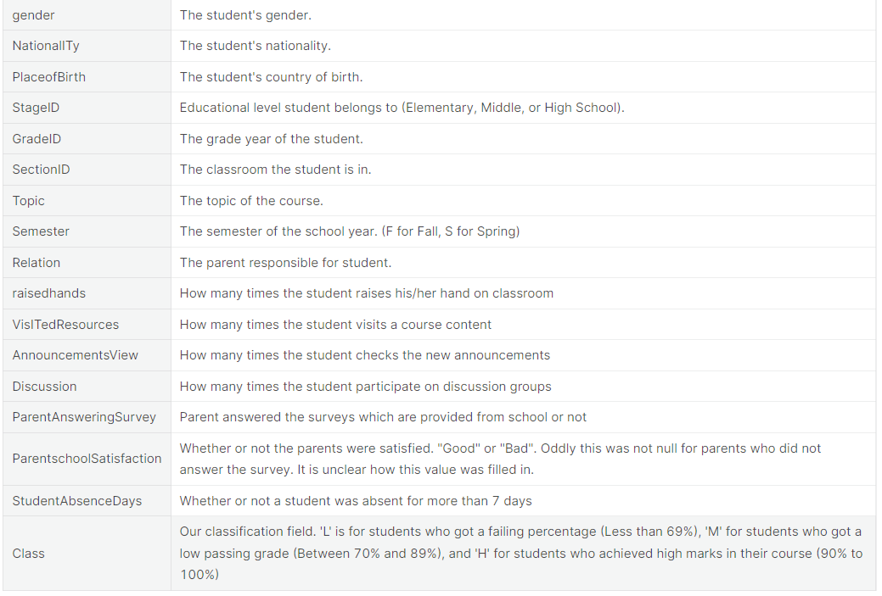
Data Description

Slide 6
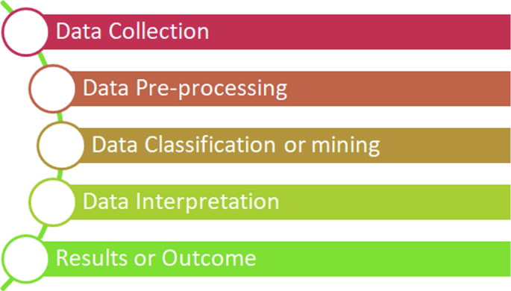
Methodology

Slide 7
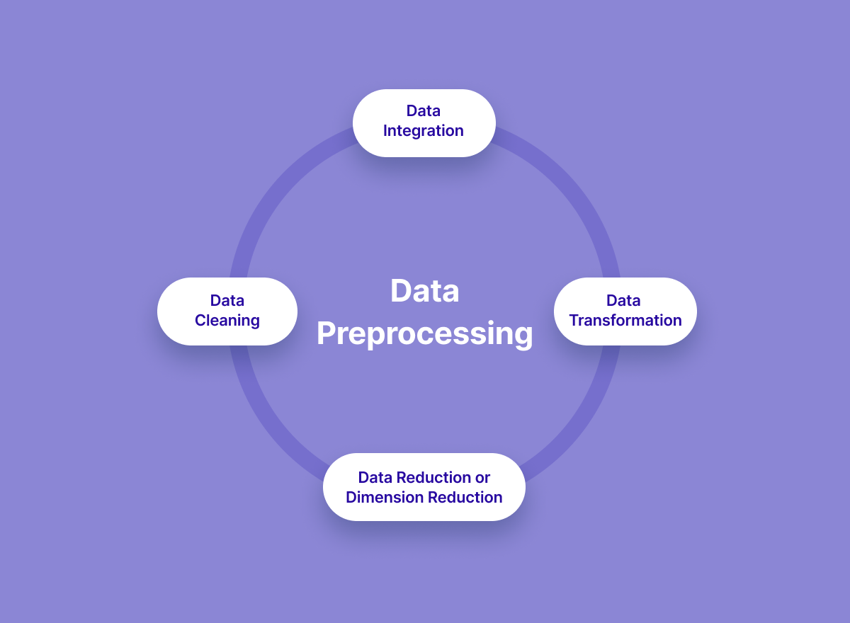
Data Preprocessing

Slide 8

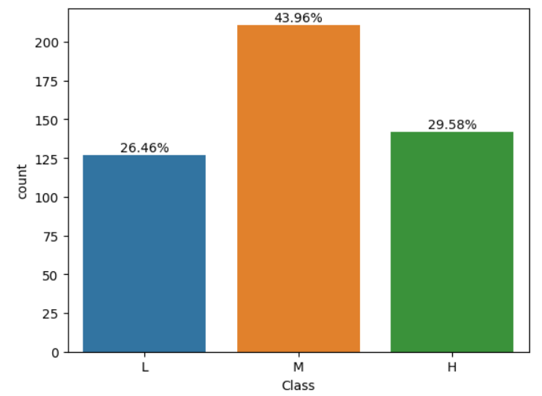
Models Used
Data visualization
Data visualization is the representation of data through the use of common graphics, such as charts, plots, infographics, and even animations. These visual displays of information communicate complex data relationships and data-driven insights in a way that is easy to understand.

Slide 9
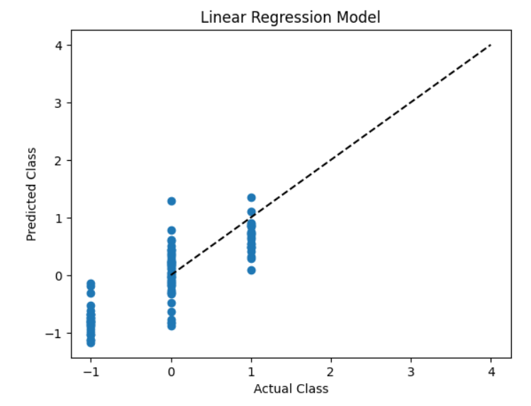
Linear Regression:
Linear regression is a data analysis technique that predicts the value of unknown data by using another related and known data value. It mathematically models the unknown or dependent variable and the known or independent variable as a linear equation.

Slide 10


Decision Tree
A decision tree is a non-parametric supervised learning algorithm, which is utilized for both classification and regression tasks. It has a hierarchical, tree structure, which consists of a root node, branches, internal nodes, and leaf nodes.

Slide 11
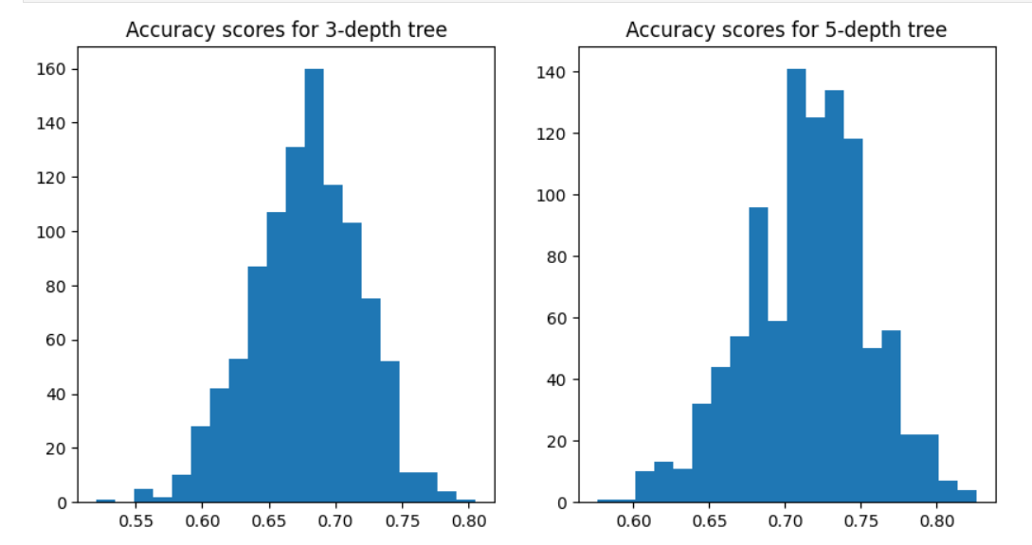
Decision Tree Graph

Slide 12
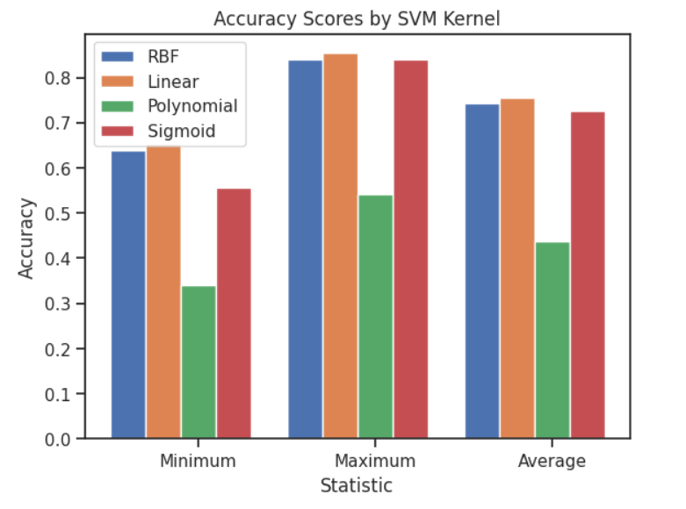
SVM Algorithm
Support Vector Machine” (SVM) is a supervised learning machine learning algorithm that can be used for both classification and regression challenges. However, it is mostly used in classification problems, such as text classification

Slide 13
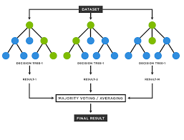
Random Forest
Random forests or random decision forests are an ensemble learning method for classification, regression, and other tasks that operates by constructing a multitude of decision trees at training time. For classification tasks, the output of the random forest is the class selected by most trees

Slide 14
NULL Values And OUTLIERS
Null values
outliers
Missing data, or missing values, occur when you don't have data stored for certain variables or participants.
Data can go missing due to incomplete data entry, equipment malfunctions, lost files, and many other reasons.
In any dataset, there are usually some missing data.
Definition of outliers. An outlier is an observation that lies at an abnormal distance.
from other values in a random sample from a population.
In a sense, this definition leaves it up to the analyst (or a consensus process) to decide what will be considered abnormal.

Slide 15
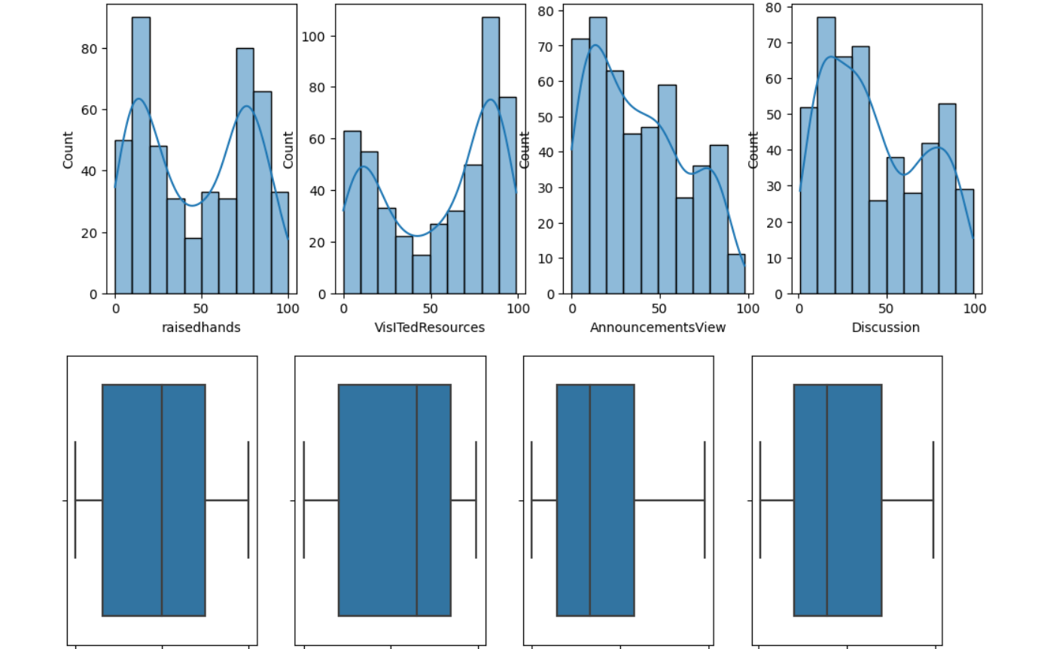

NULL Values And OUTLIERS Graph

Slide 16
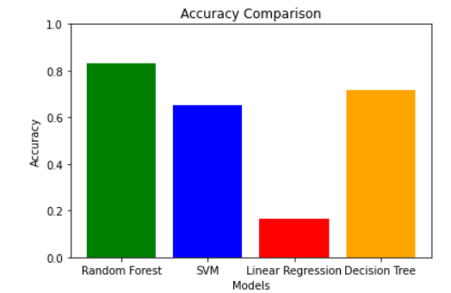
Accuracy Comparison

Slide 17
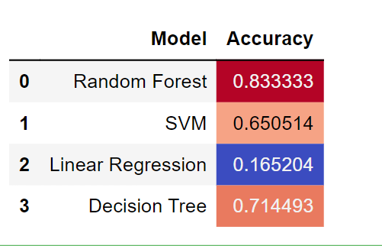
Inference Table

Slide 18
Future Scope Improvements
Various schools and colleges institutions can use these models and modify them according to their needs to use in their student improvement status. This will reduce the manual labor and time spent on determining whether to performance of a student is good or not.
Parents who intend to take a report can use these trained models to check whether their child’s performance will be good or not. The trained models would be required to be implemented in a platform.
We saw a high value of the correlation of the "class" attribute with our target attribute. But the feature importance of the "class" attribute was significantly lower. With more data and further analysis, it might be possible to describe the reason for this mismatch.
All the applicants having the value "class" in the "Performance" attribute were to understand the good and bad performance in the class. With further research and more data for analysis, a more decisive conclusion can be made

Slide 19

Summary
Predicting student academic performance has long been an important research topic in many academic disciplines. An extensive literature review shows that the present study is the first study that develops and compares four types of mathematical models to predict students academically.

Slide 20


Thank You

